Slide 1

Spelling Practice Application With Feedback
Presented By: Muhammad Bin Khalid & Ahmad Arshad

Slide 2
Overview and Key Features
Objective
Features
This application is designed to help users improve their spelling skills through interactive practice.
Practice spelling words from a predefined list or a custom list.
Add new words to the practice list.
Delete words from the practice list.
Track user progress and provide feedback.

Slide 3
The Spelling Practice Process
Start Session
1
Users initiate a spelling practice session by selecting the word list.
2
Word Display
The application displays a word for the user to spell.
User Input
3
Users enter the spelling of the word in a designated input field.
4
Feedback
The application provides immediate feedback on the spelling accuracy.
Continue Practice
5
Users can continue practicing until they have completed the chosen word list.

Slide 4

Adding New Words
User Request
Word Validation
Users can add new words to their custom list via a dedicated interface.
The application validates the word input to ensure it is spelled correctly.
List Update
The custom word list is updated with the newly added word.

Slide 5
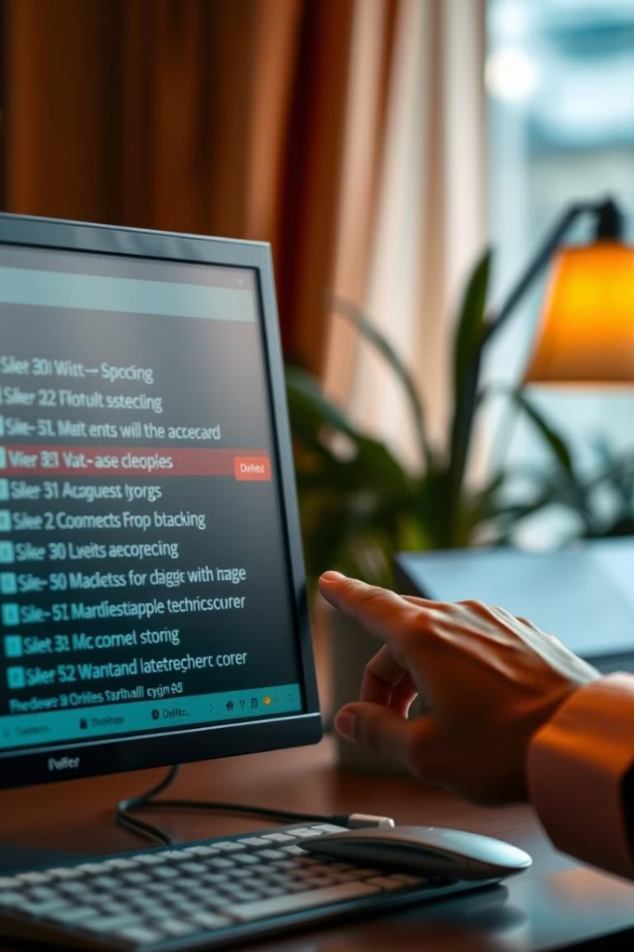


Deleting Words
Select Word
List Update
Users can choose a word they want to remove from the practice list.
The word is removed from the practice list, and the updated list is saved.

Slide 6




Customizing the Word List
Load from File
Users can import a list of words from a text file.
Save to File
Users can export their custom word list to a text file.
Edit List
Users can manually add, delete, or modify words in their custom list.

Slide 7

Providing Feedback and Encouragement
100%
0%
Correct
Incorrect
Displays a positive message for correctly spelled words.
Provides helpful hints and guidance for misspelled words.

Slide 8



Conclusion and Next Steps
Future Enhancements
1
The application tracks the percentage of correctly spelled words.
Expand Word Lists
2
Include different themes and difficulty levels
Gamification
3
Introduce points and achievements to motivate users

